Slide 1
JeoPARDY! Project
By:
Yarithe Karim
(Rumon)
Sagnik Chakrabarti
(NIK)

Slide 2

PROBLEM
There’s no easy way to play a modern Jeopardy online and track your progress using a simple login system.
I want questions that I can answer, and I want to keep track of my high score

Slide 3
Introduction
Our goal with this project was to create a functional good-looking game of Jeopardy using HTML, CSS, and PHP. Players will be able to login and keep an account to track their high score as play the familiar game of Jeopardy where you answer questions for money. The higher the reward of the question, the more difficult the question is.

Slide 4
Goals
To equally distribute the workload amongst our team and coordinate progress using the Scrum methodology
To have an engaging game experience for the user with stimulating visuals which promote competitiveness and trivia fun, and learning
Use HTML to create a Jeopardy webpage that will allow the user to interact with different pages and buttons. Showing them questions and displaying their name and score.
Use PHP to allow the user to answer questions, store data about their login information and keep track of their score and allow users to sign up.
Use CSS to amplify the visual aspect of the game to make sure it doesn’t look unappealing.
Use TXT files to store questions, answers, and users in an accessible easy way.

Slide 5
SCRUM METHODOLOGY

Slide 6
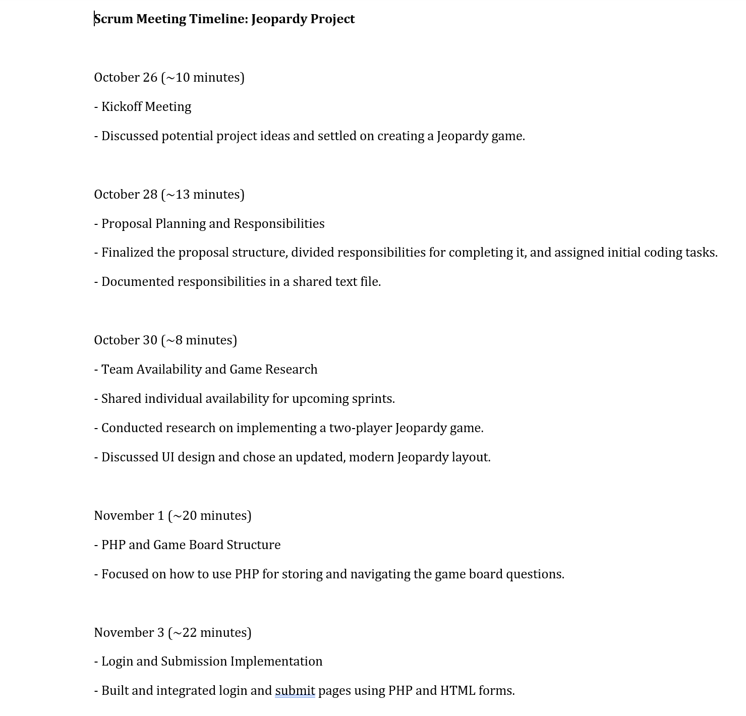
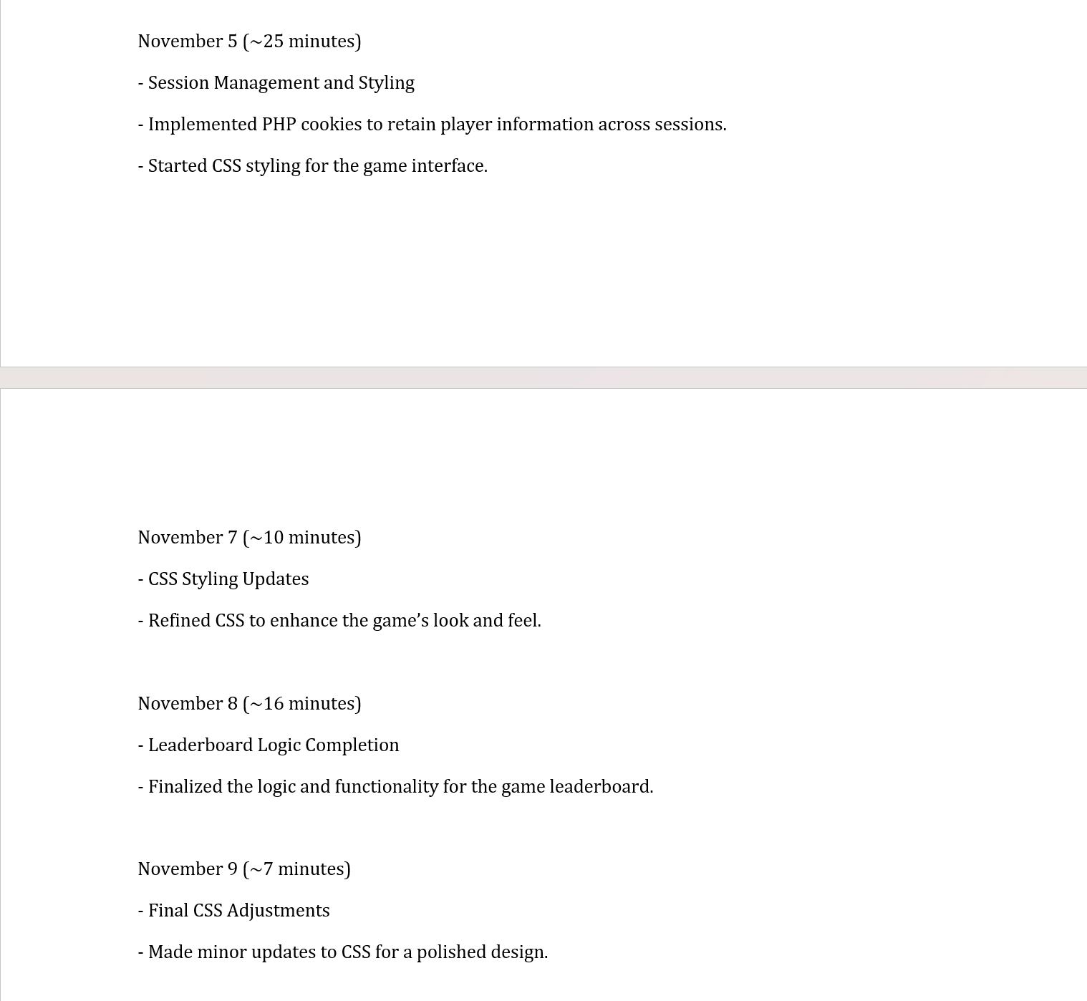

Slide 7
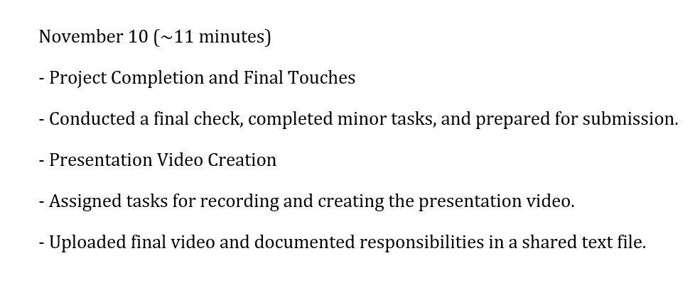

Slide 8
Demo link: https://codd.cs.gsu.edu/~ykarim1/jeopardywebapp-main/mainpage.php

Slide 9
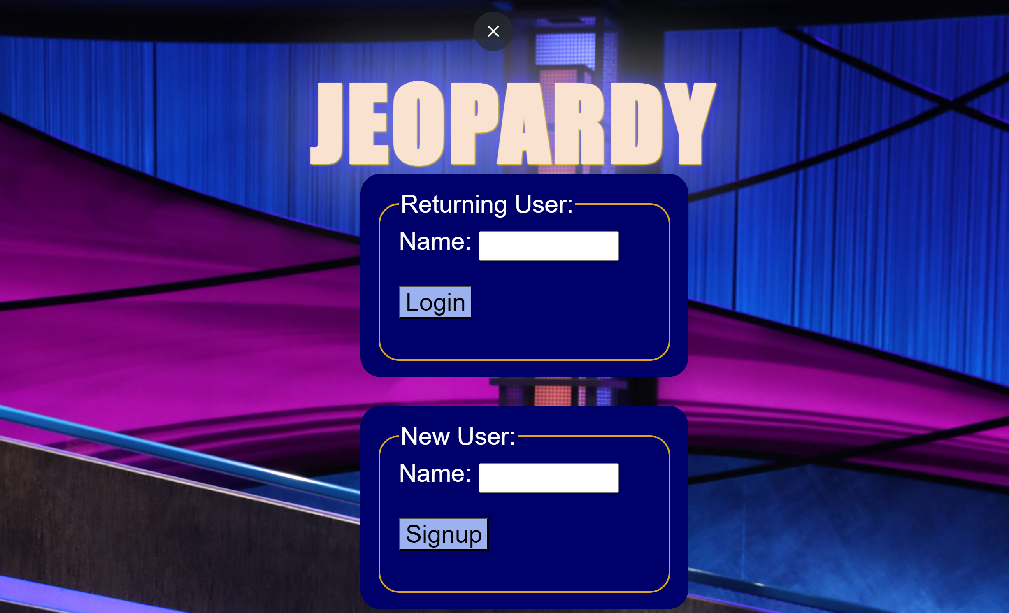

So how?

Slide 10
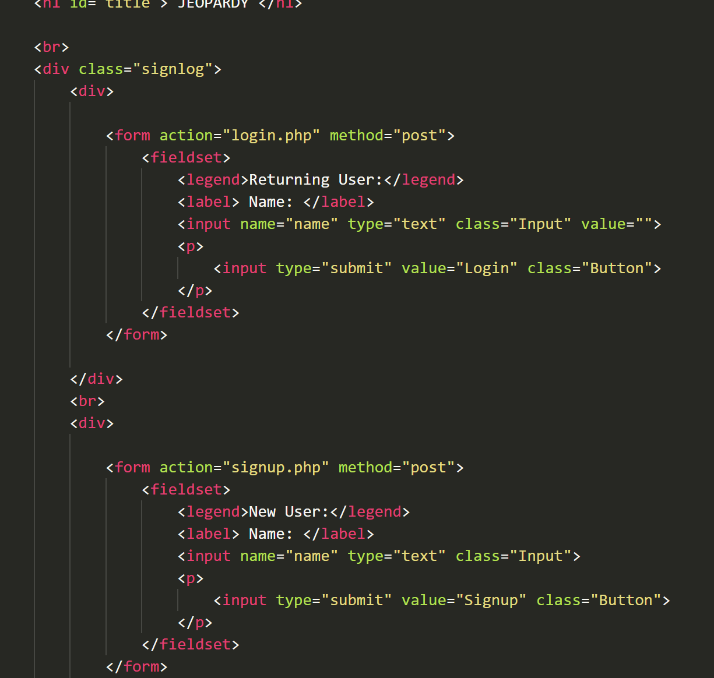
MAINPAGE.PHP
HTML code that runs a webpage for the home screen
Contains references to two PHP forms: login and signup which are used to help the user make and maintain an account to keep track of their high score.
Has labels and buttons to make the experience simple for the user.

Slide 11
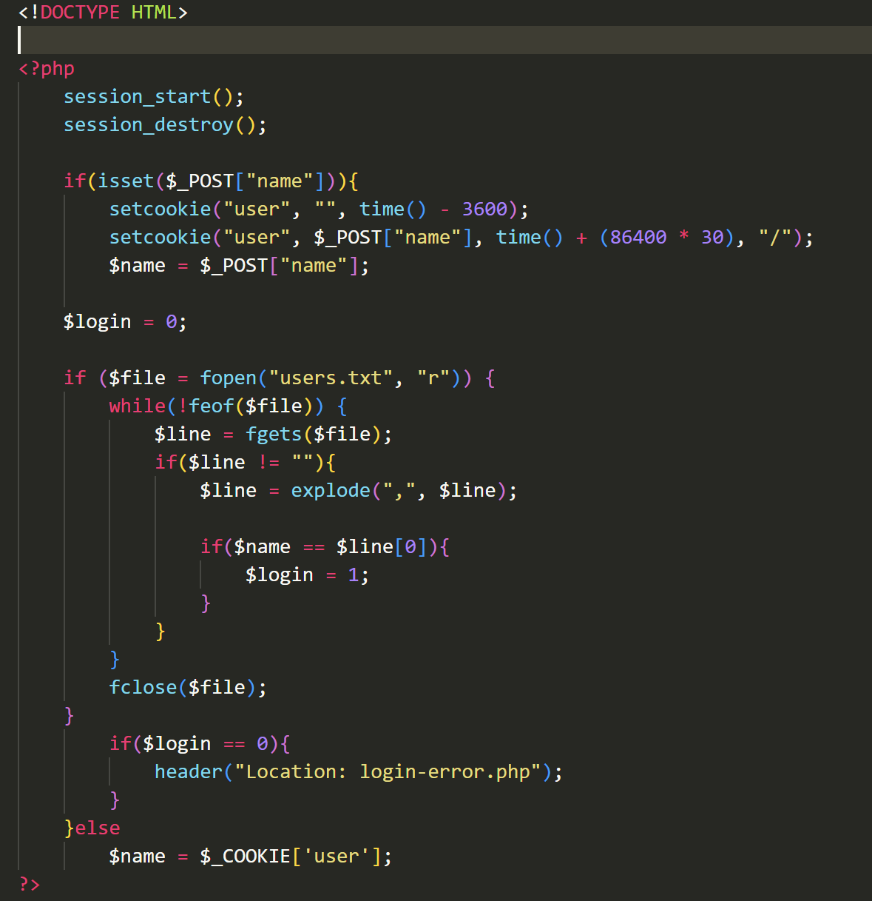
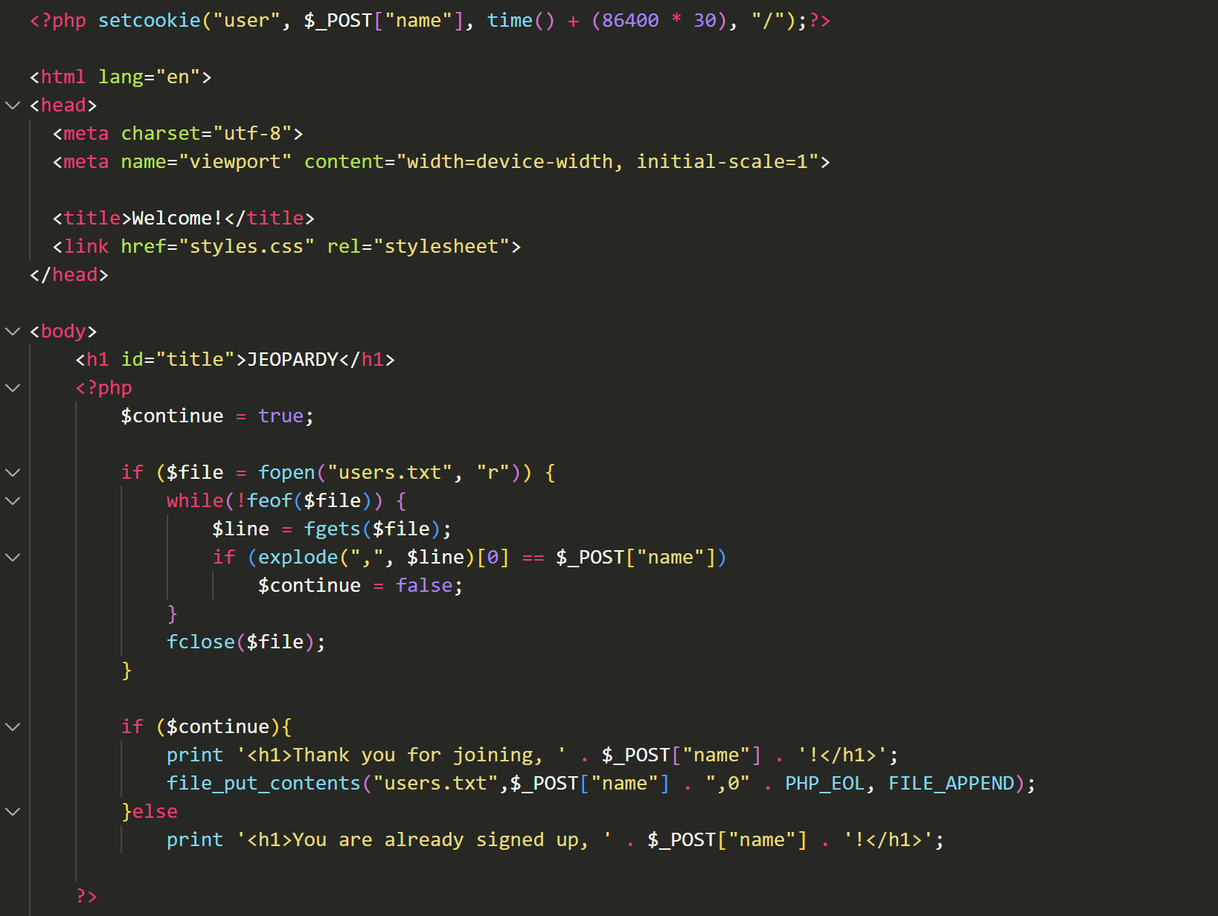
Login.php
signup.php

Slide 12
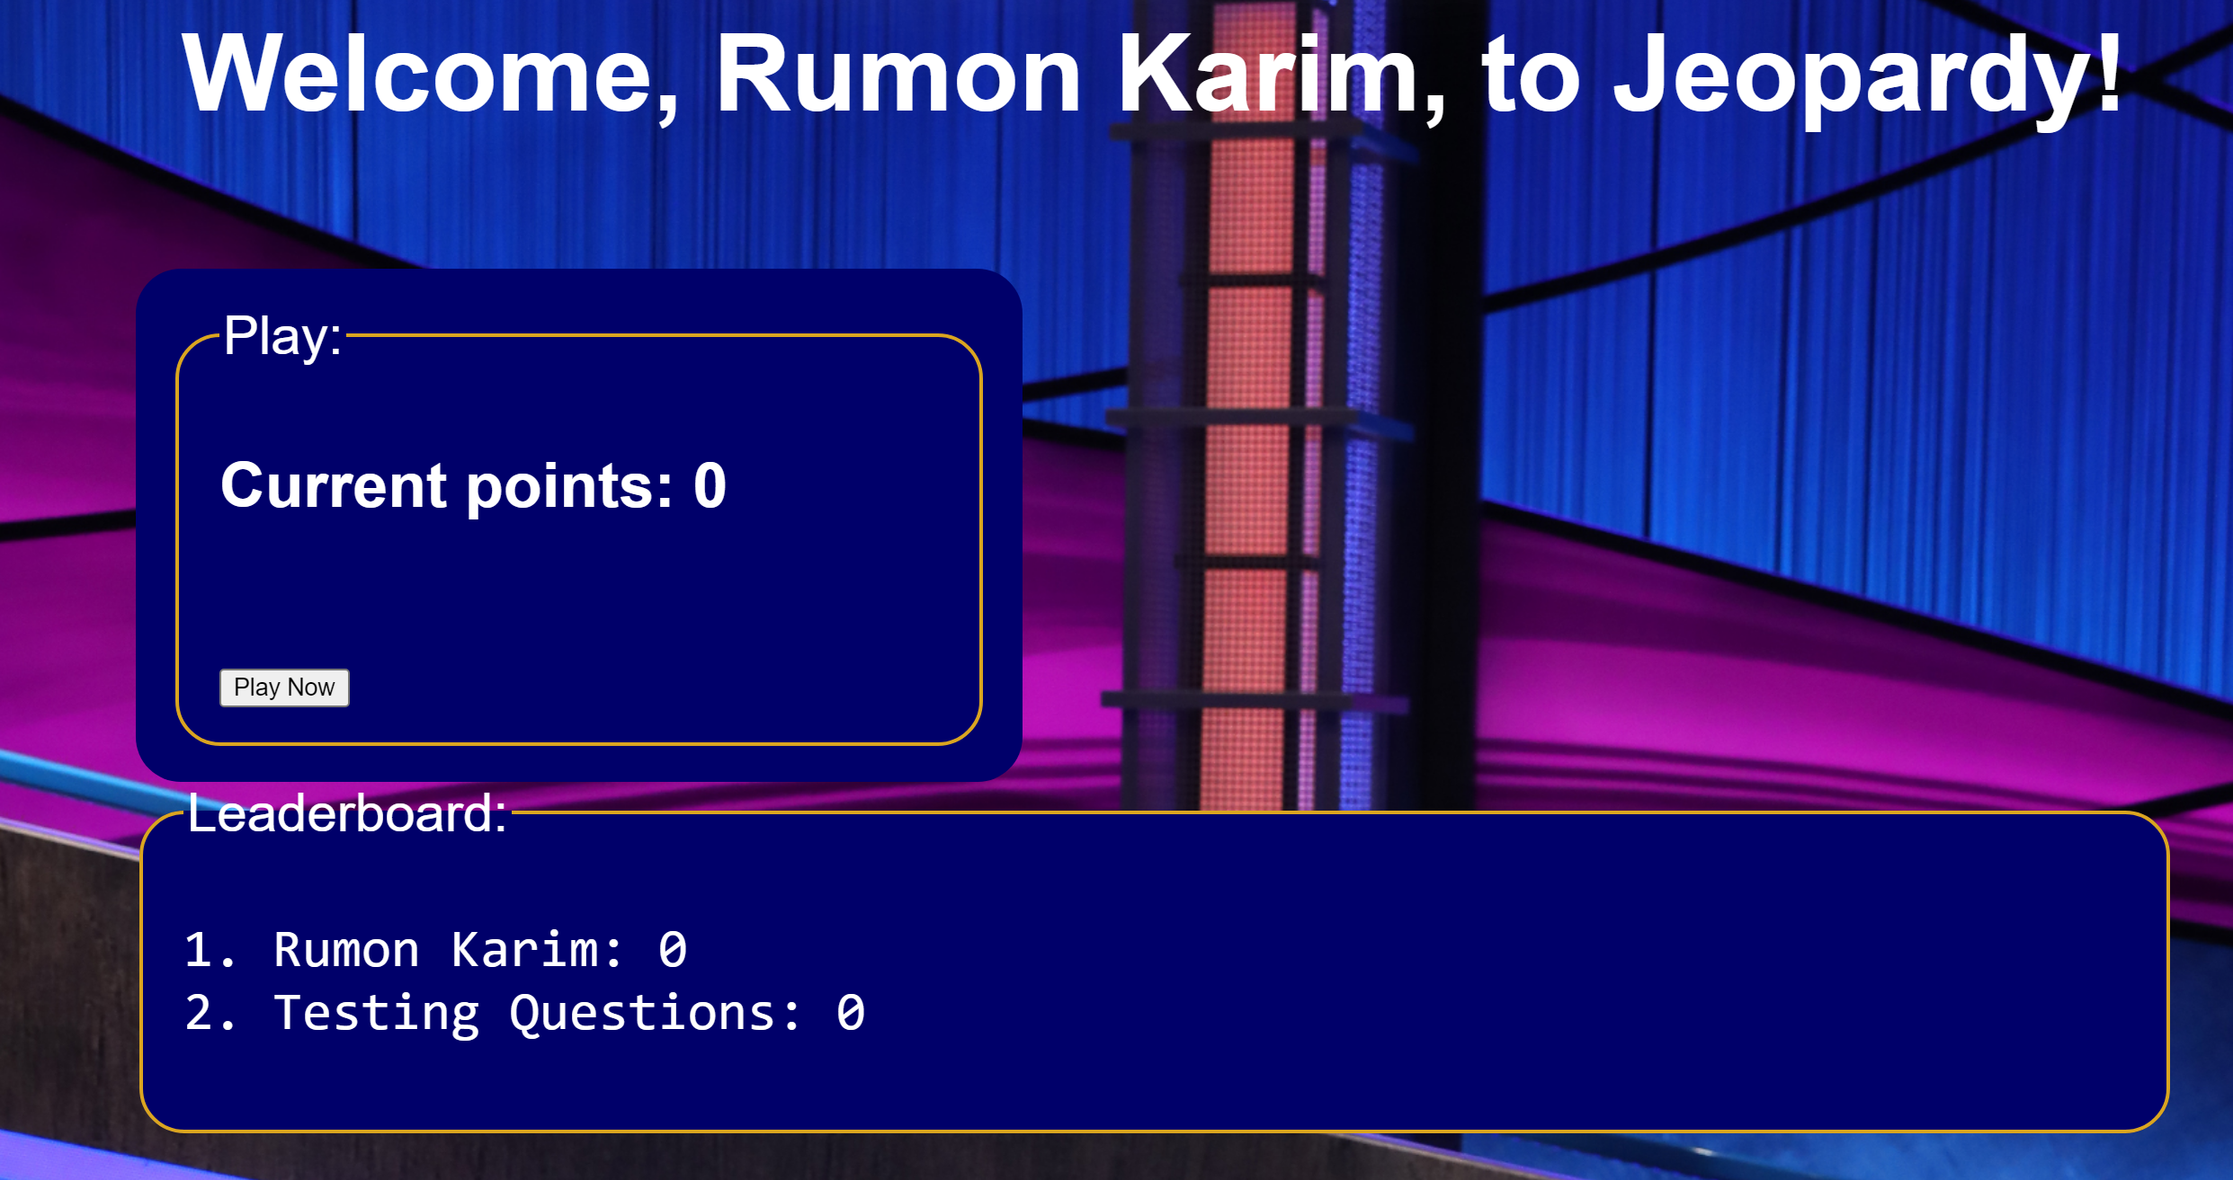
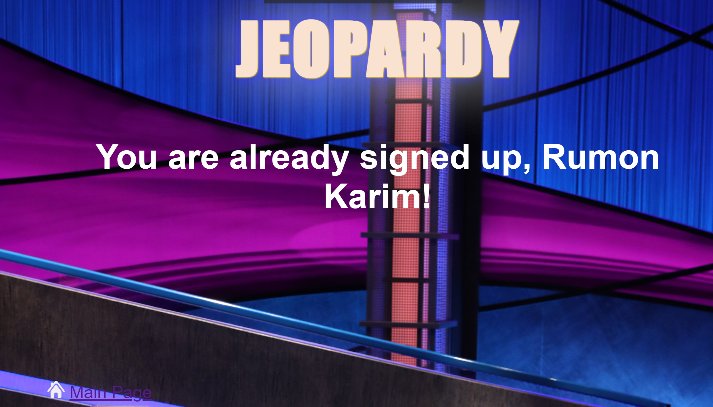
Account system php
LOGIN.PHP
The login form uses users.txt to check if the user has signed up
If they have, it will redirect the user to a page with their name and stored points. This page has a leaderboard containing all of the names in users.txt
If they haven’t, it will display a login error page
SIGNUP.PHP
The signup form uses users.txt to check if the user has already signed up
If they have, it will let them know and direct them back to the homepage.
If they haven’t, it will display a welcome message and add their name to the file.

Slide 13
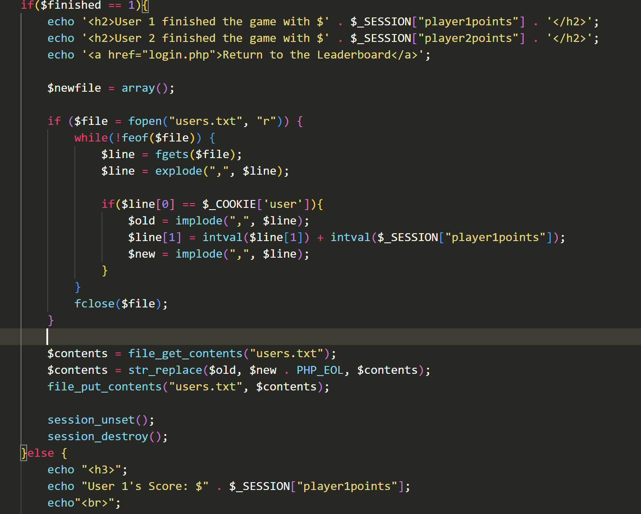
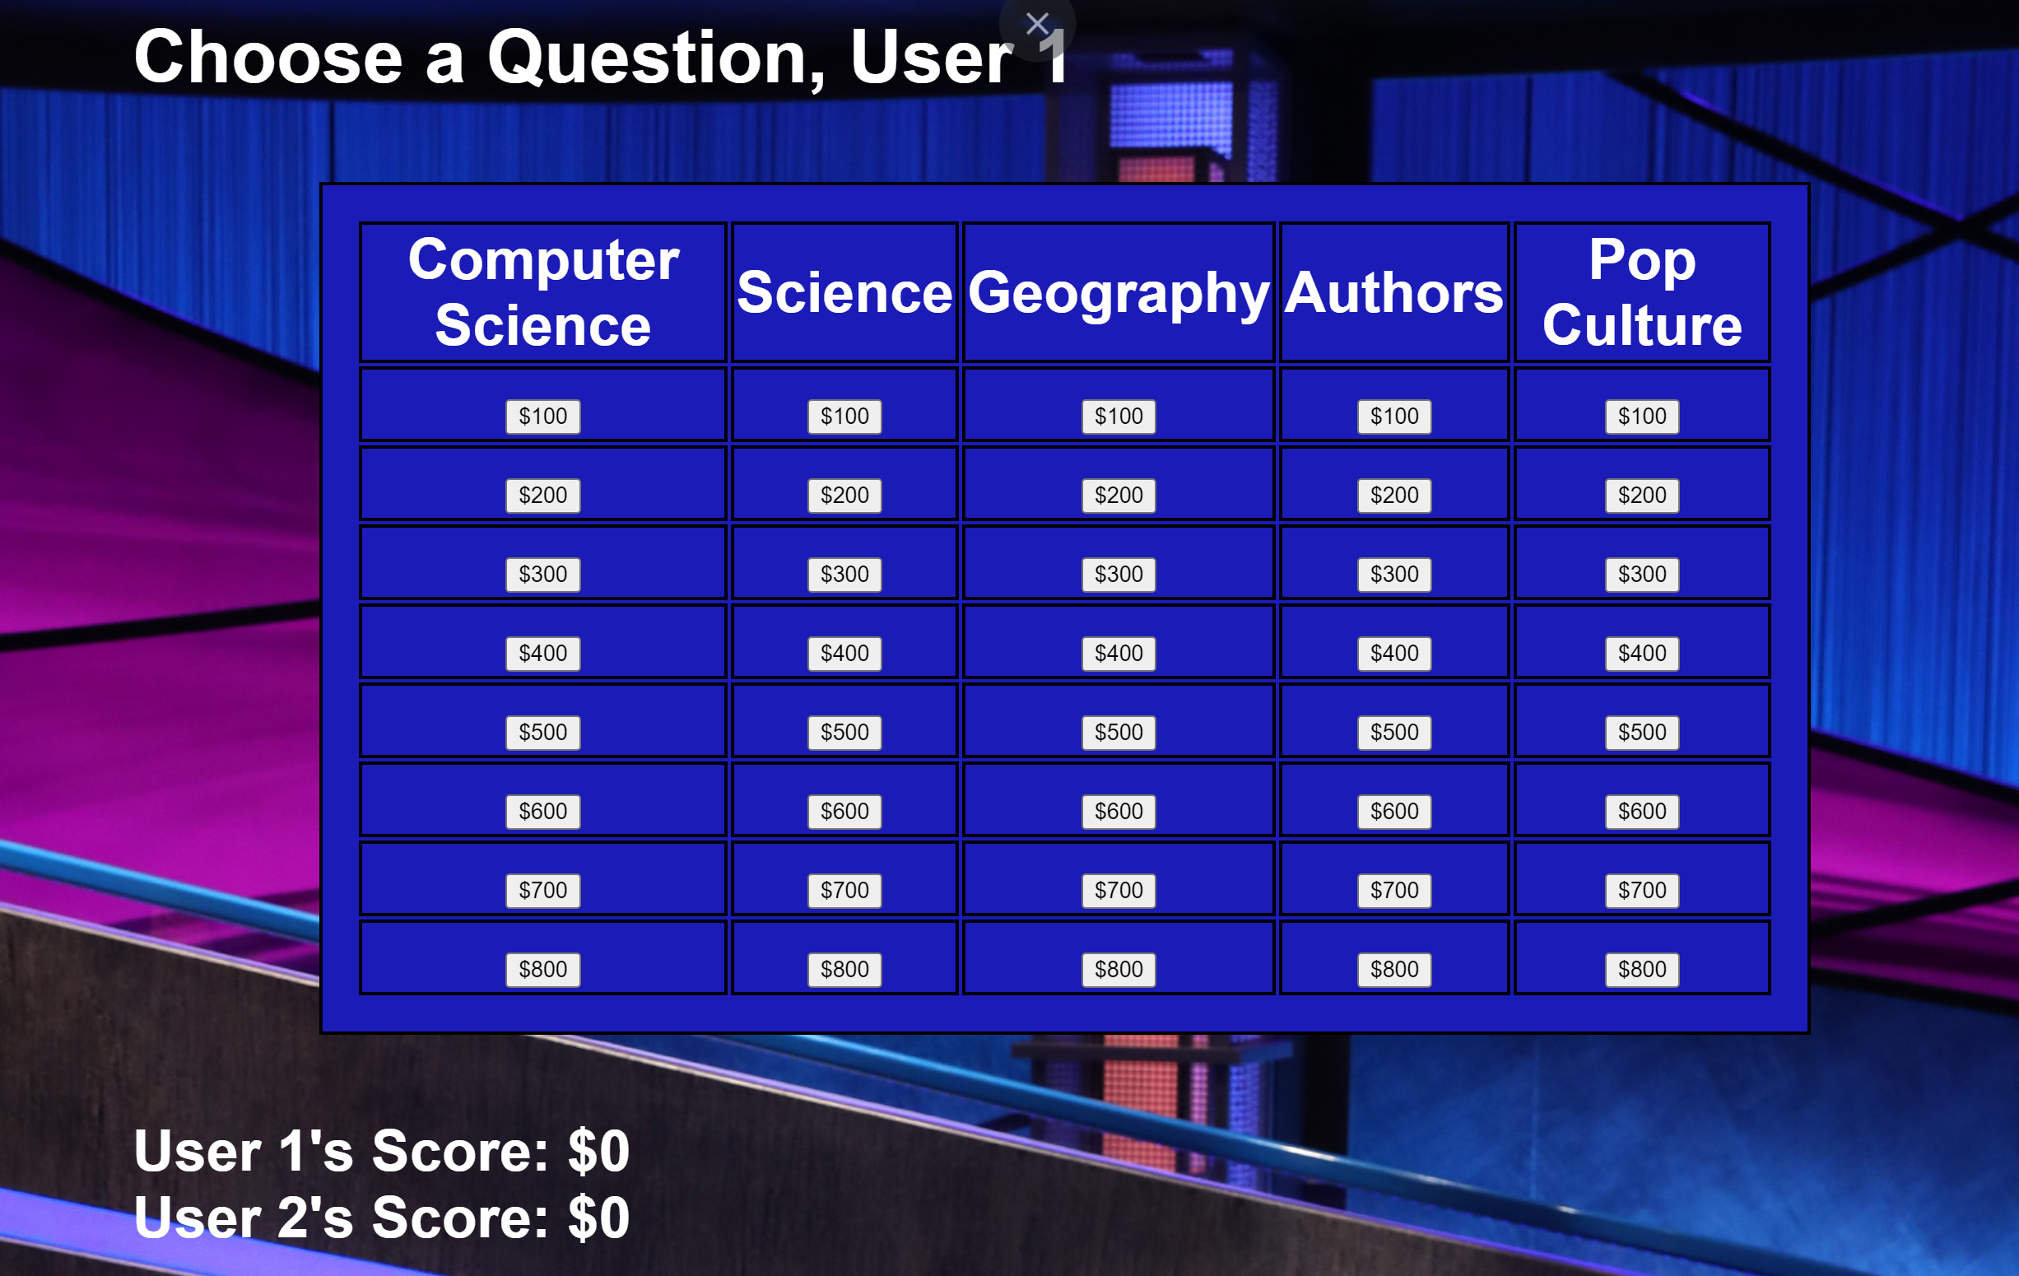
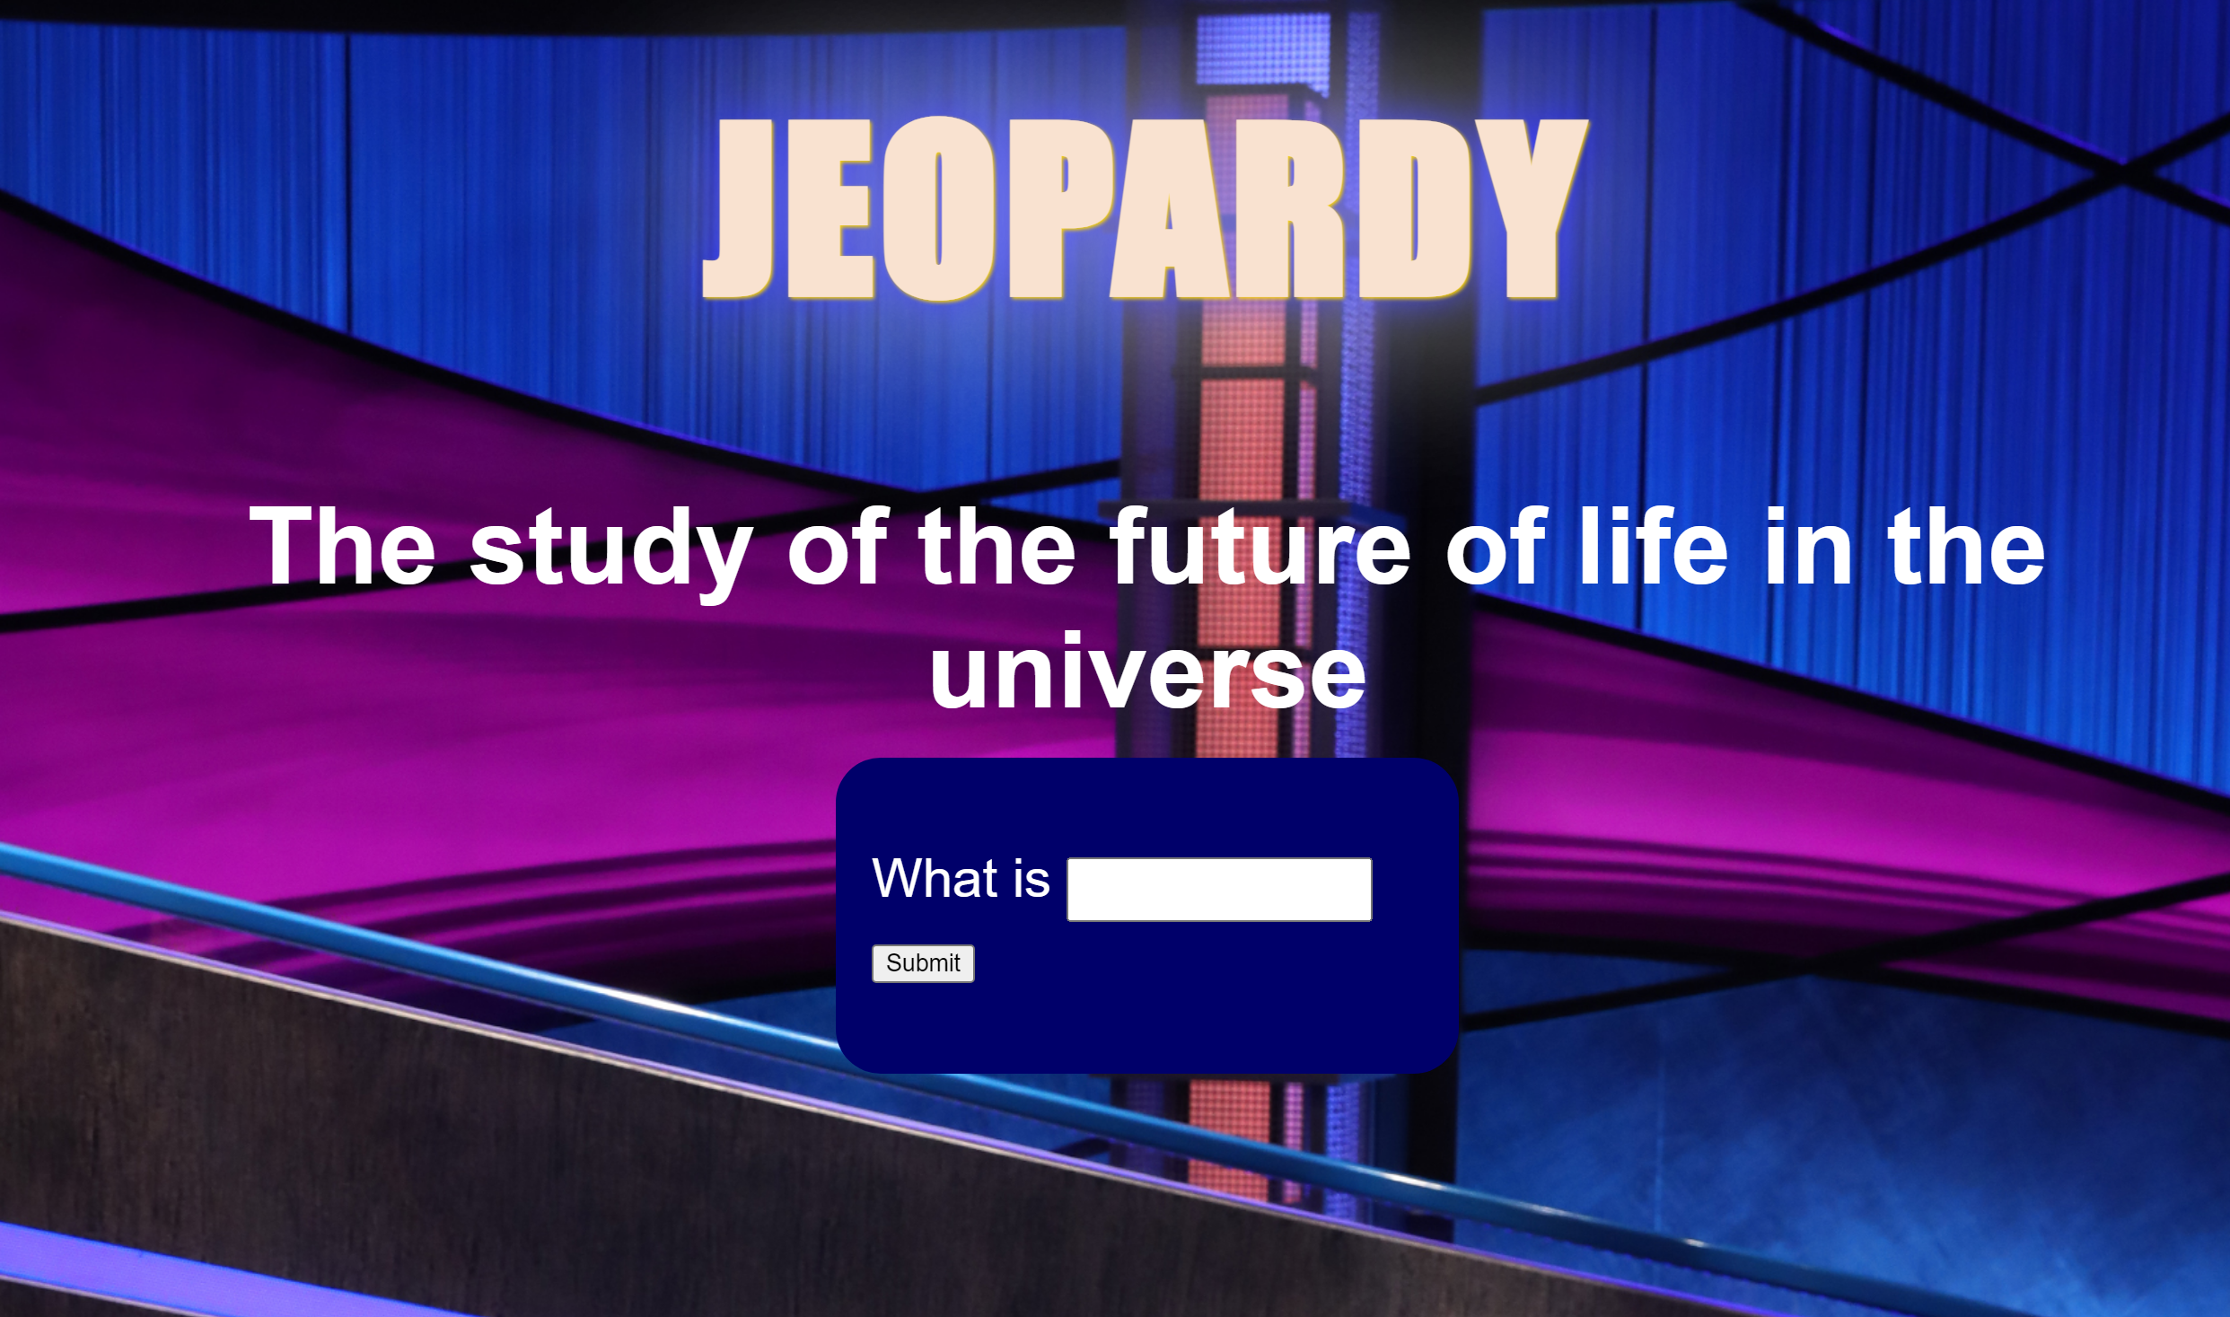
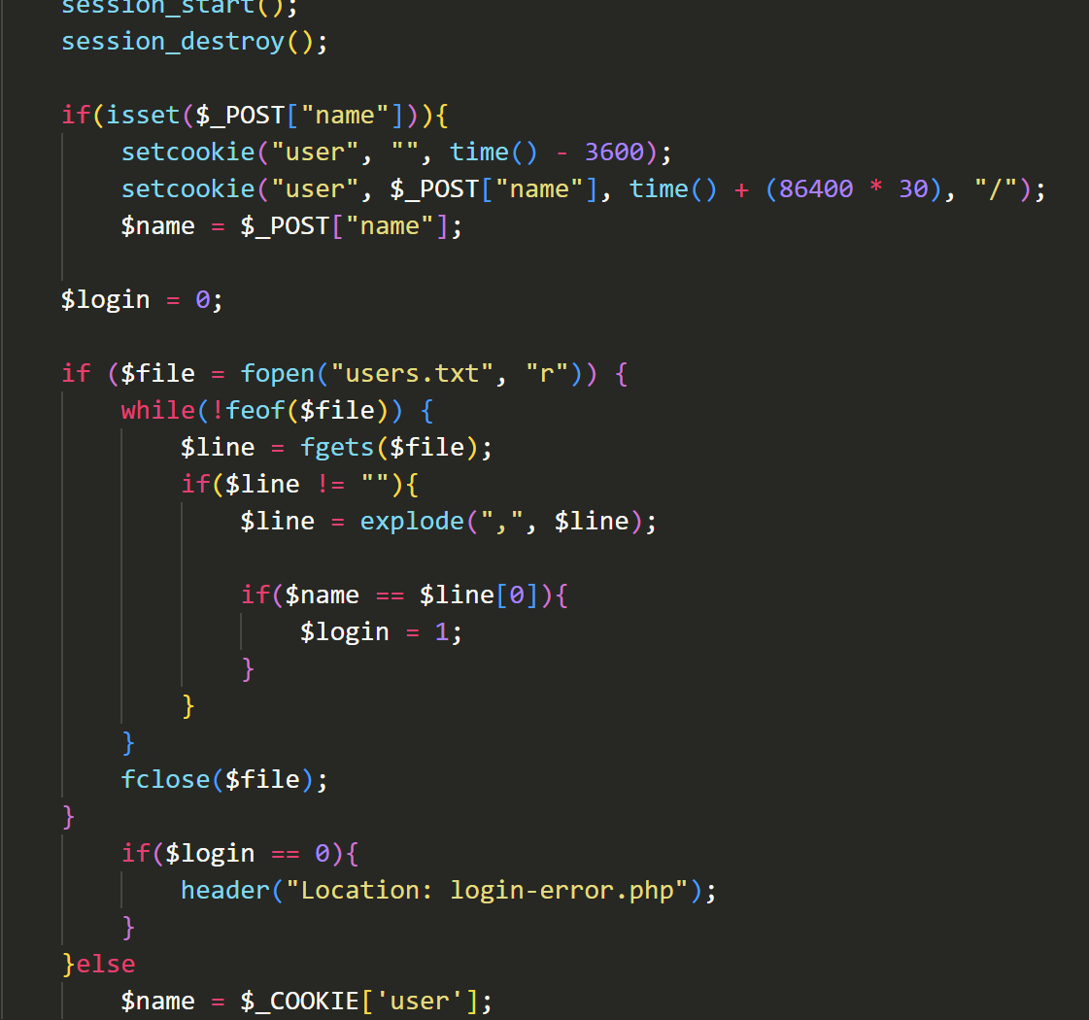
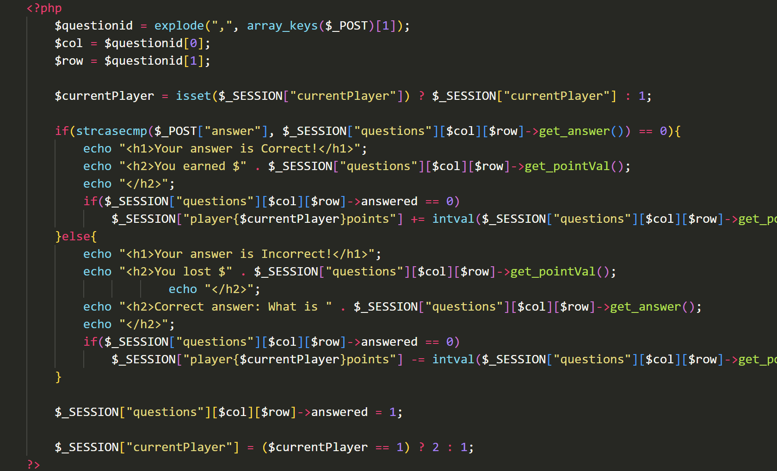
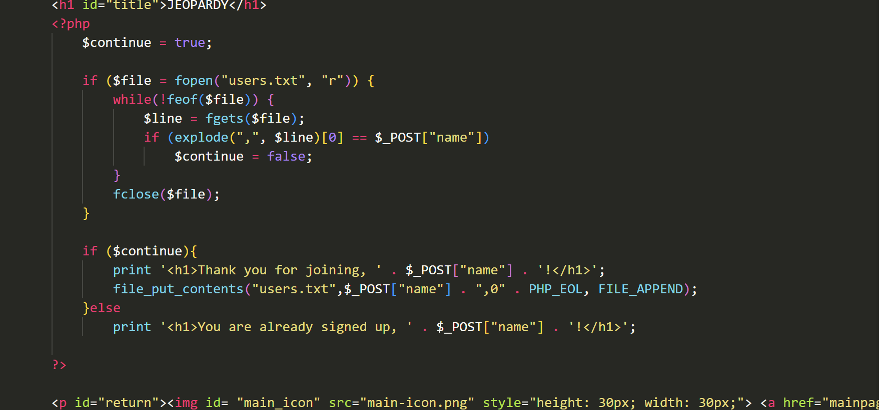
The code for these pages is extensive, so we’re going to choose a few key coding segments that I think are important to understanding the overall flow of the project.

Slide 14
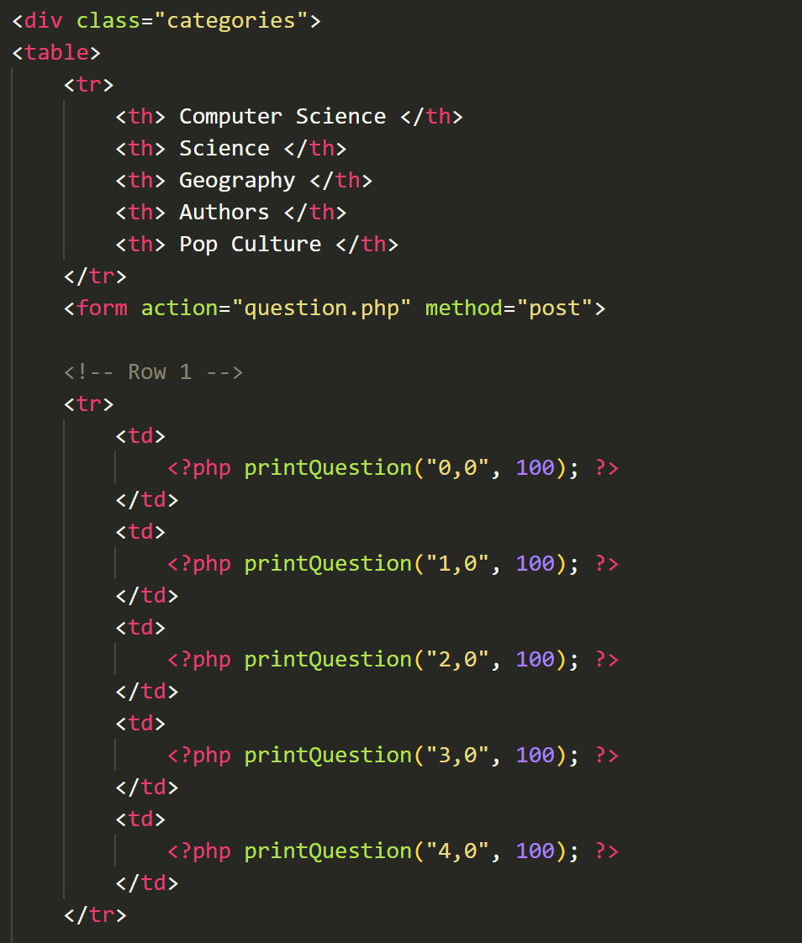
Table
The game table is made using HTML DIVS and a table. The code generates a board and questions each new session.
printQuestion() is a PHP function that is used to link the board to each question. For example (“0,0”, 100) refers to 0 for the first category (CS) and 0 for the first question, 100 being how much the question is worth. The actual question page is a separate page of code, and the questions are written on a txt file based on the category.

Slide 15
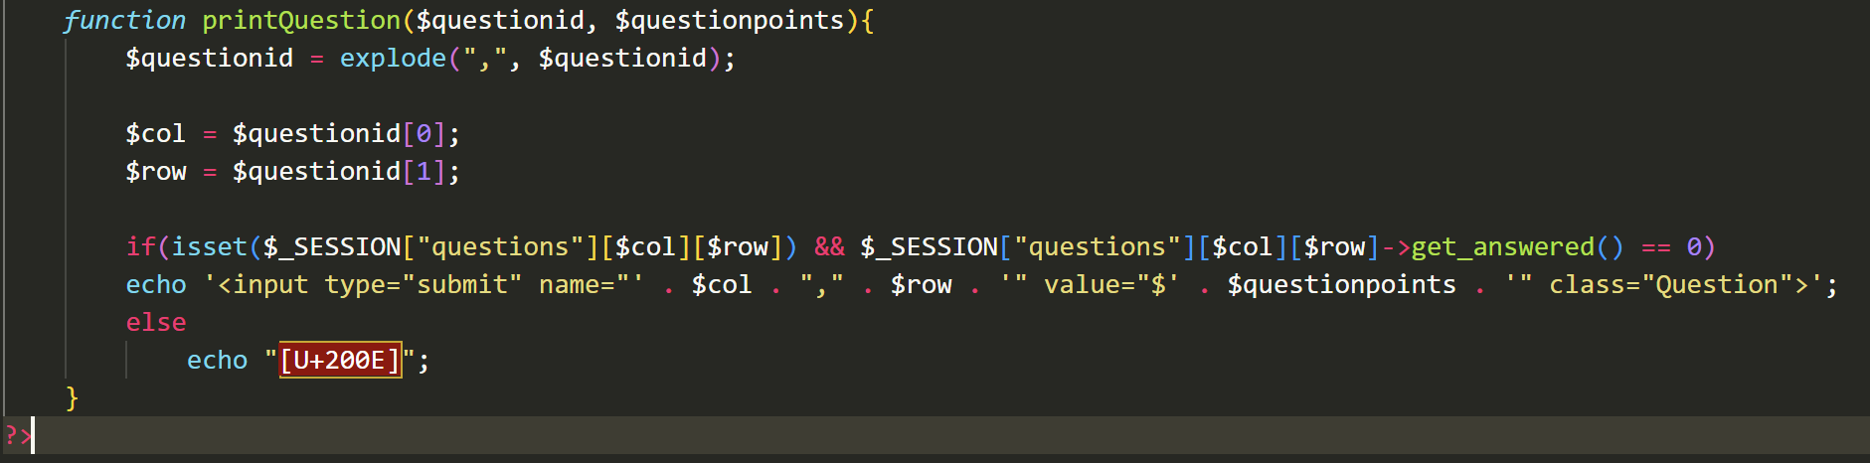
Table
This function generates an HTML button for the question. It then parses the question ID in the format of (column, row) and explode splits the string into two parts. It checks if the question is available and displays the question. If it isn’t available, it does not display the button.

Slide 16
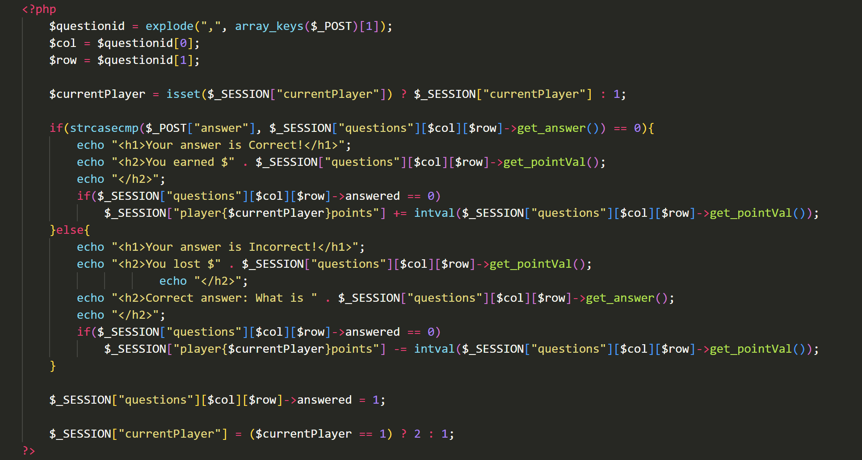
How does answering a question work?
This function may look complicated but what it does is quite simple.
It checks if the user’s answer is correct
If it is, the user’s points are increased by the amount the question was worth.
If it isn’t, the user’s points are instead decreased.
After updating the user’s points, it marks the question as answered and switches to the next player

Slide 17
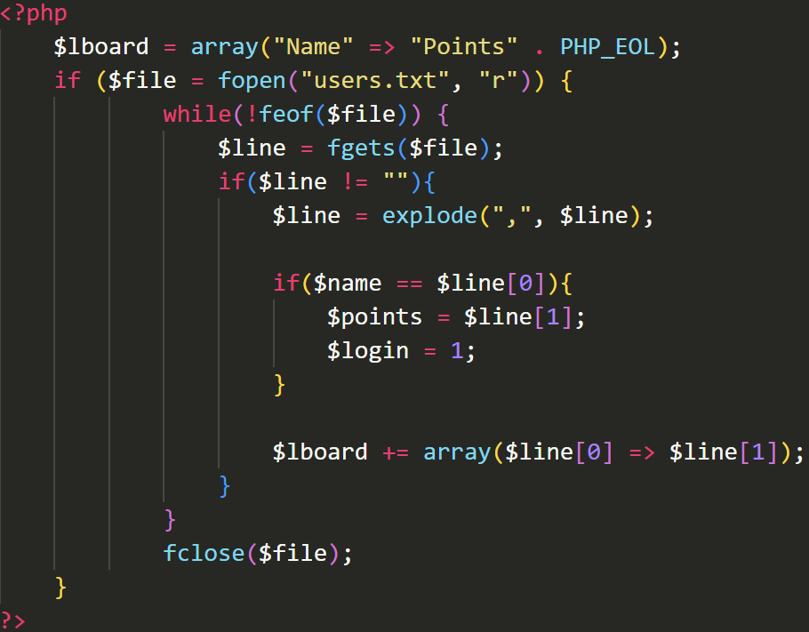
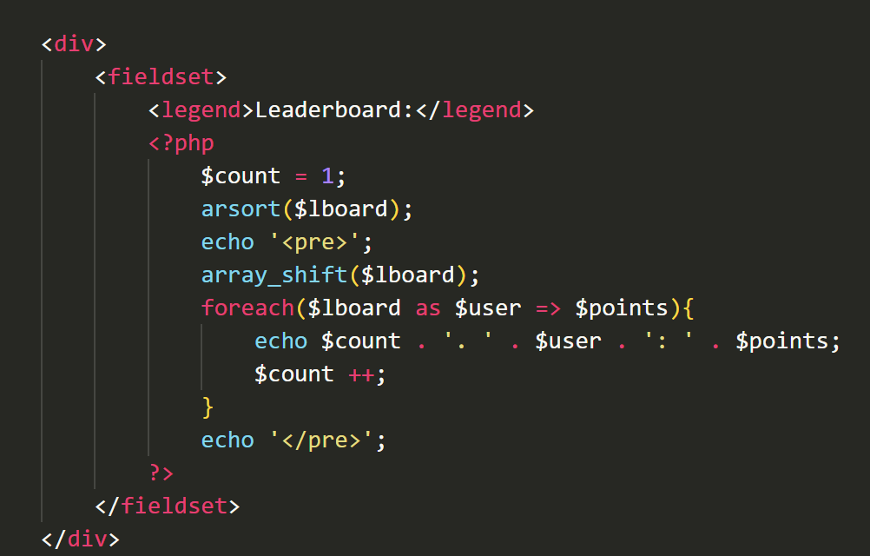
Leaderboard
The $lboard variable reads from users.txt and populates an array with names as the keys and their points as values.
It checks if the current user’s name matches one of the names in the file, and if it does, it stores the user’s points and updates the login flag.
The second script sorts the array in descending order and removes the header with array_shift().
It loops through the array, displaying each user’s rank, name, and points.

Slide 18
Features to be implemented later
More users at once
Keep track of two logins at once
Double and Final Jeopardy
Question Stealing

Slide 19
Thank you!

